Slide 1

Contractor Training
2023-2024
2023-2024
Presentation to ALL VCAAA GRANTEES
June 21, 2023

Slide 2
Goals of This Presentation
1
To understand our roles as partners
To maintain compliance with regulations
2
3
To address questions and concerns

Slide 3
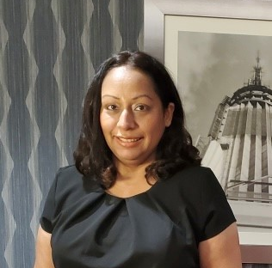
Who Are We? Front Desk Representative
Sonia Torres
Customer Relations Specialist

Slide 4
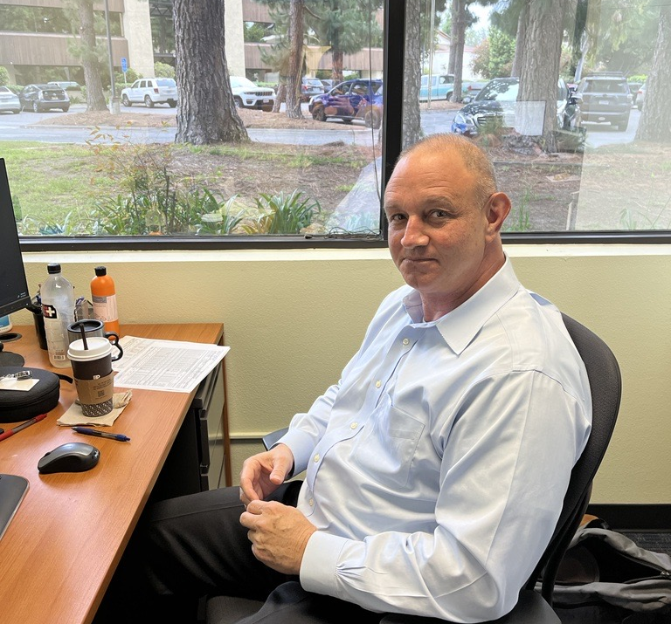
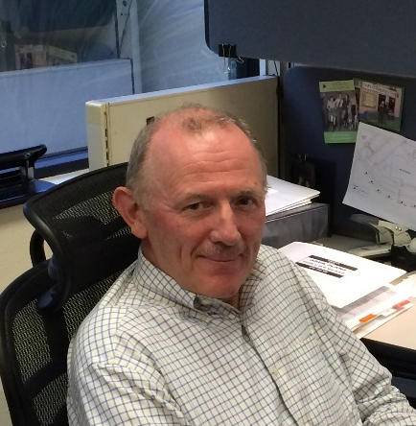
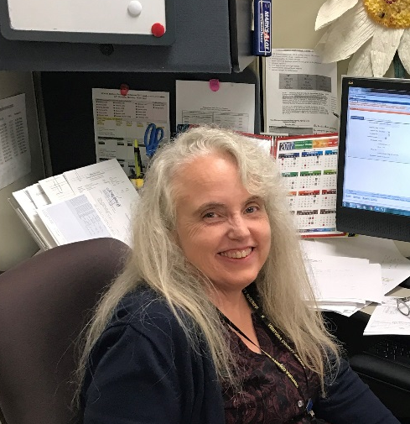
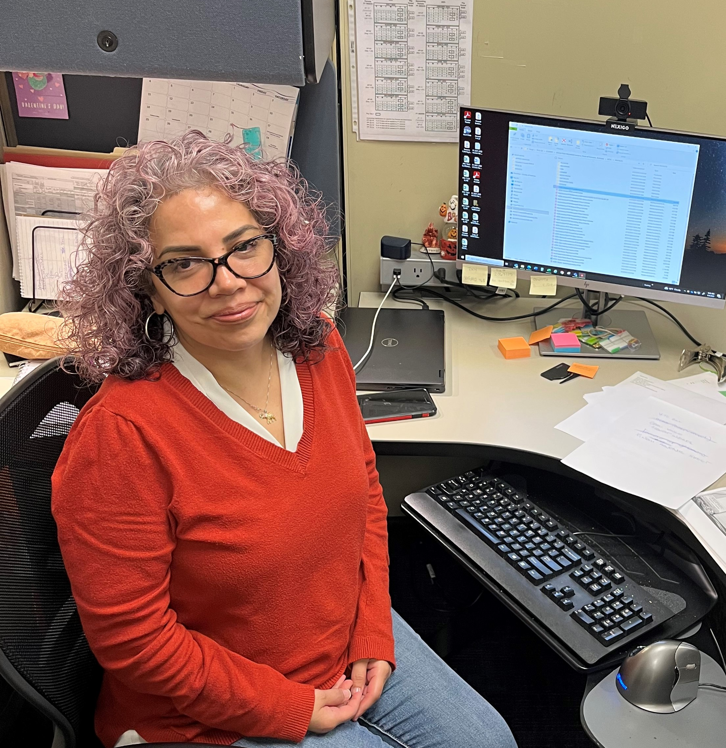
Who Are We? Fiscal Department
Tony Allen
Senior Accountant
Brian Murphy
Fiscal & Contracts Manager
Connie Riedmiller
Senior Accounting Assistant
Claudia Castaneda
Senior Accounting Technician

Slide 5
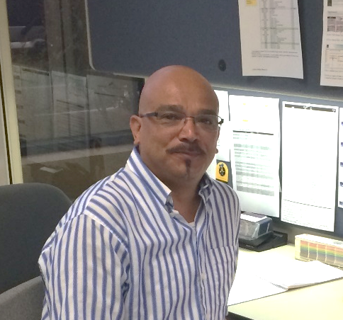
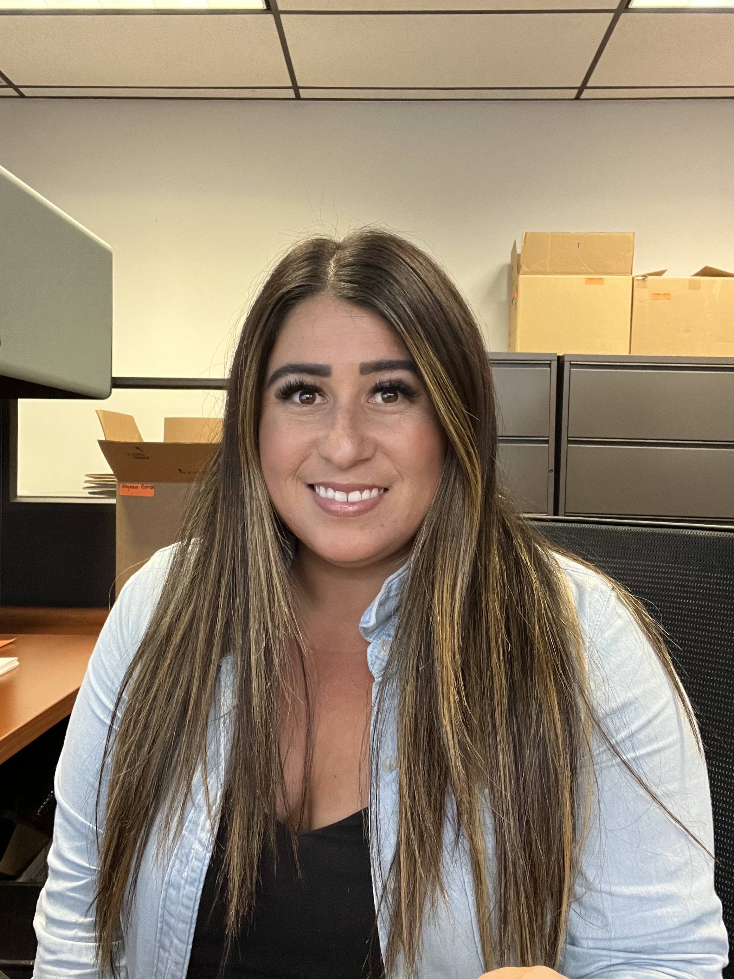
Who Are We? Data Integrity, Grants Administration
Martin Marquez
Data Integrity/Facilities Manager
Alyssa Corse
Grants Administrator

Slide 6
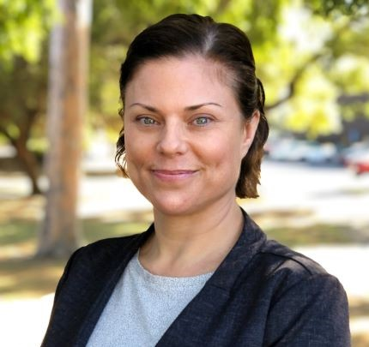
Who Are We?
Information & Assistance
Denise Noguera
Contact Center Manager
Social Workers:
Teo Nguyen
Brianna Kelly
Celeste Lopez
Jasmine Keys
Jocelyn Mungaray

Slide 7
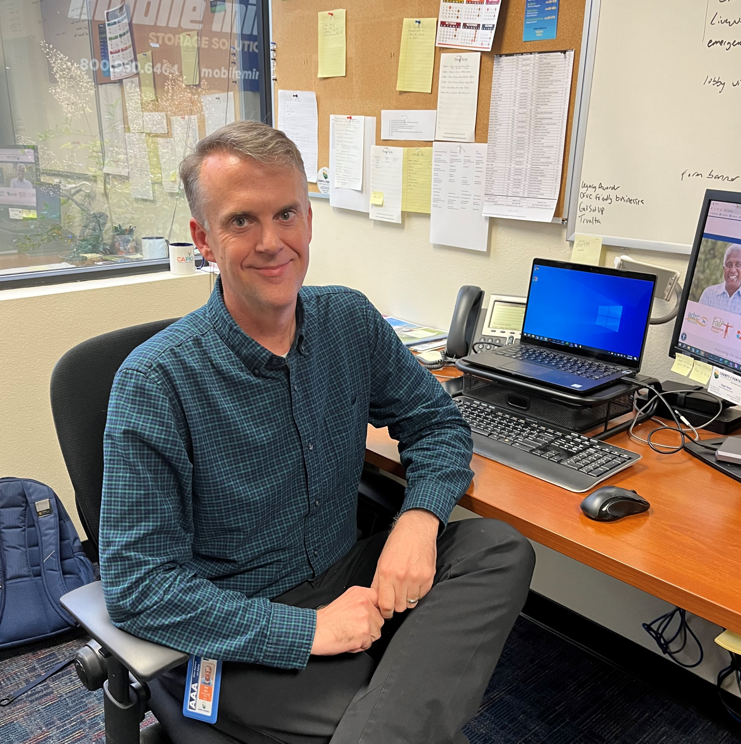
Who Are We? Public Outreach
Roger Horne, Public Information Officer

Slide 8
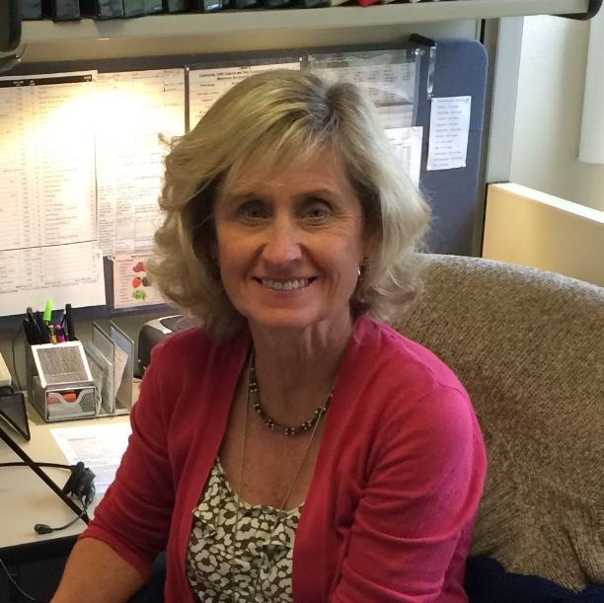
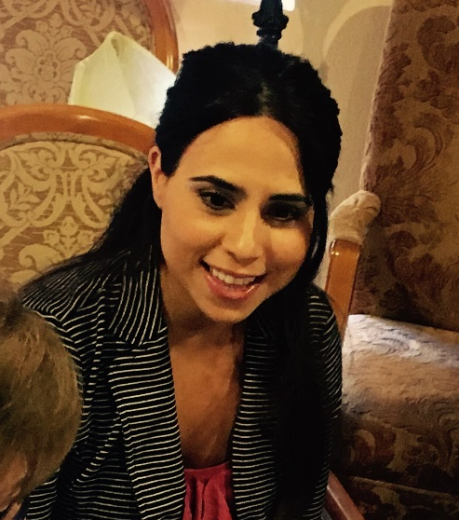
Who Are We? Senior Nutrition
Patti Jaeger
Registered Dietitian
Teresa Diaz
Registered Dietitian
Registered Dietitian (TBH)

Slide 9















Who Are You?
Nikki’s Casamia
Restaurant & Catering
Grey Law of Ventura County

Slide 10
Area Plan – Agency’s Guiding Document
Informs stakeholders about VCHSA-AAA’s goals
4-year cycle
Updated each year
VCHSA-AAA is accountable to the State of California Department of Aging (CDA) for these goals
Integral part of your contract with VCHSA-AAA
UPDATE FOR FY 2023-2024
VCHSA-AAA Master Strategic Plan
2020-2024
Year 4 of Four-Year Plan

Slide 11
Why Collect Data?
Measures each program’s success
against stated goals:
By sub-recipient & By VCHSA-AAA

Slide 12

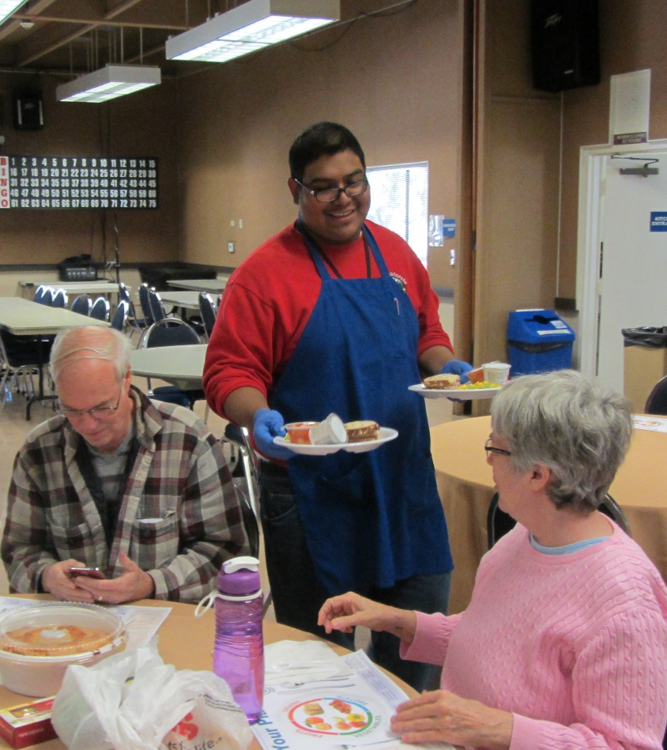
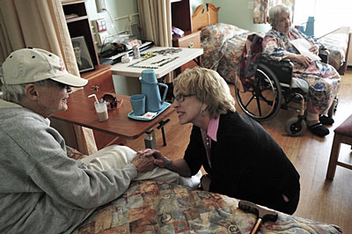
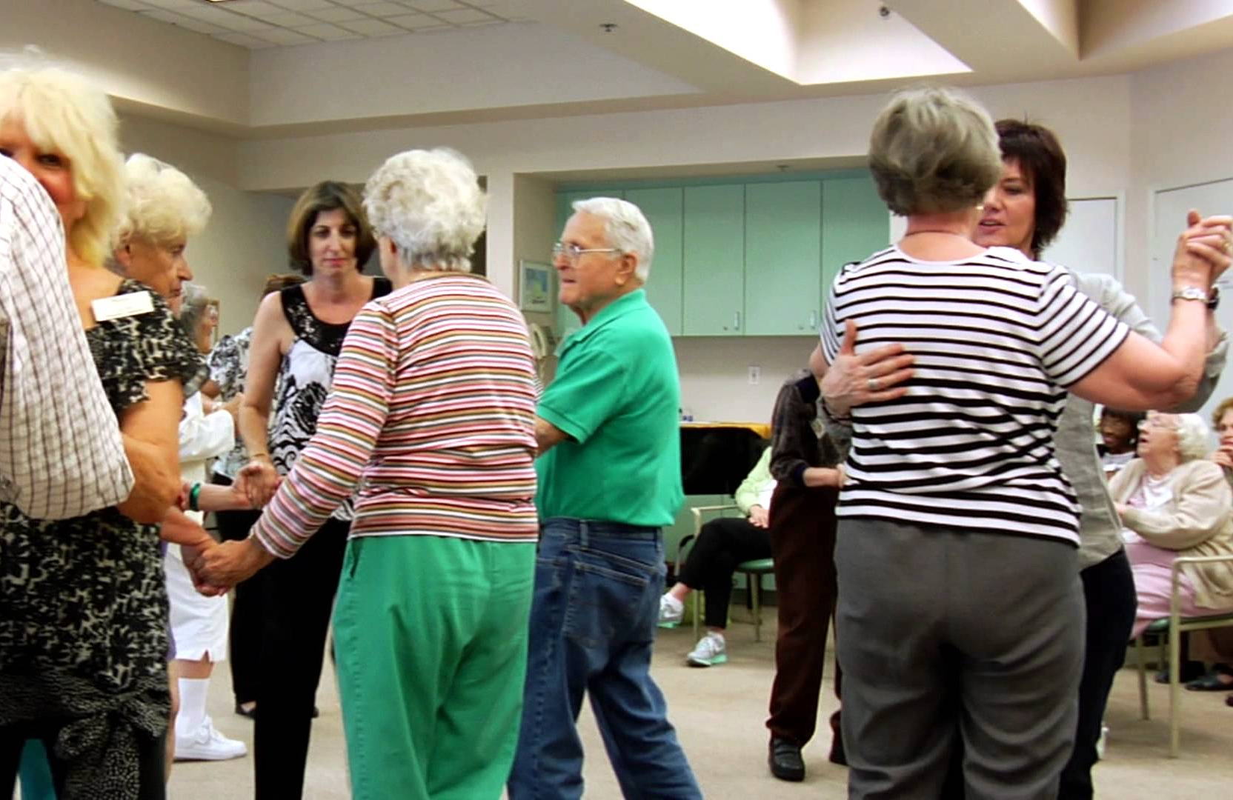
Why Collect Data?

Slide 13
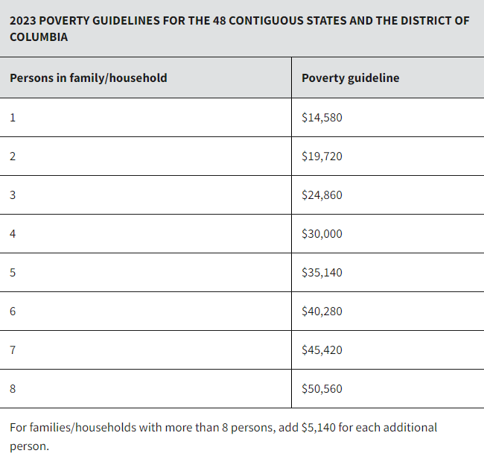
Why Collect Data?
It’s in agency’s contract with CDA
Must target services to the most needy – socially & economically
Accuracy is important!
Deadlines are important!

Slide 14
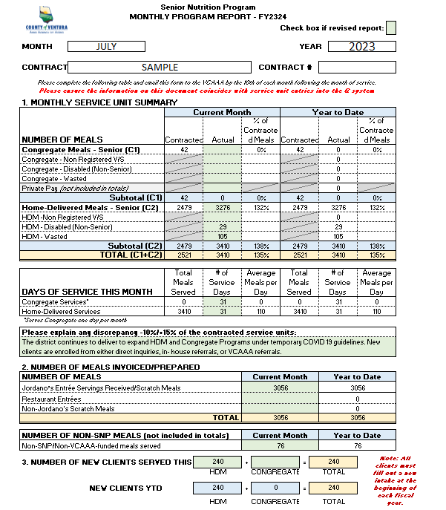
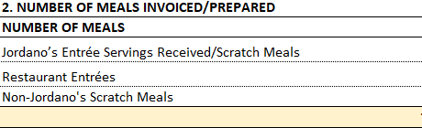
Updated Monthly Program Reports
What is a meal prepared from scratch?
Definition: Entrees paid for by meal-site.

Slide 15
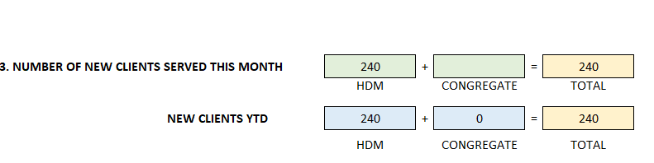
Updated Monthly Program Reports
Note: All clients must fill out a new intake at the beginning of each fiscal year.
All are considered “new” at this time.

Slide 16
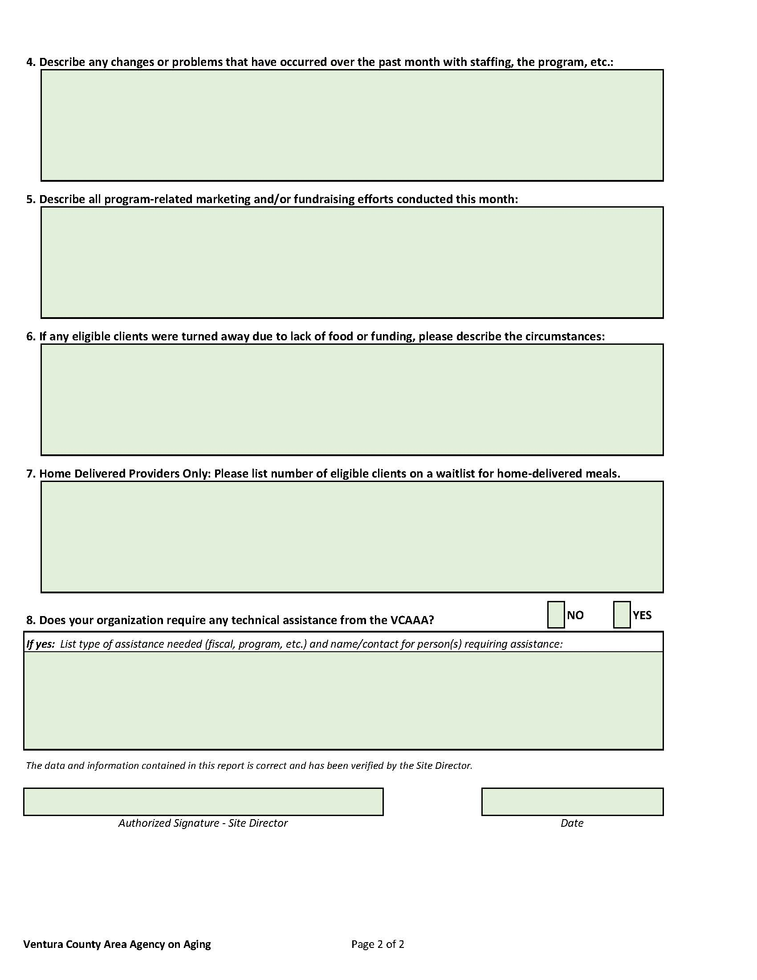
Updated Monthly Program Reports
Important Questions
By the 10th!

Slide 17
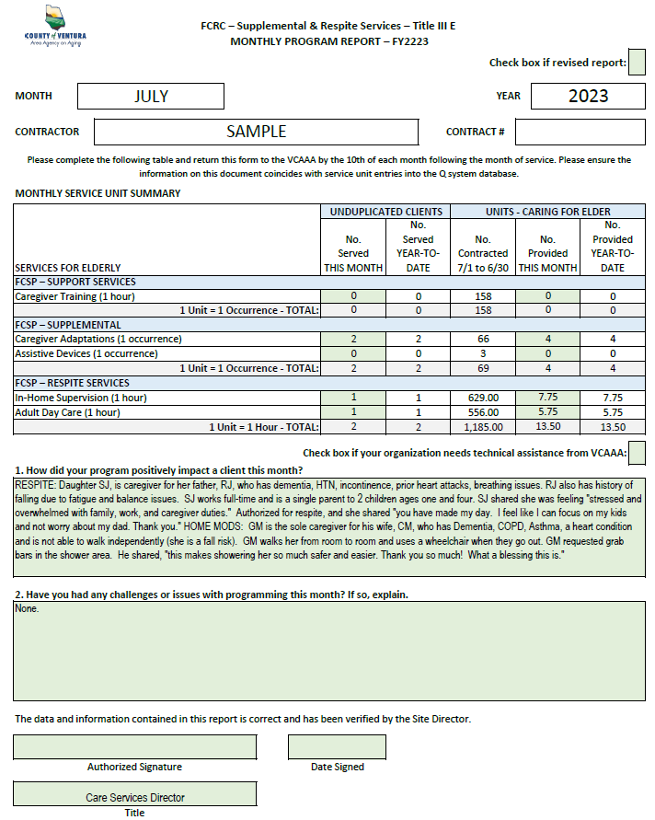
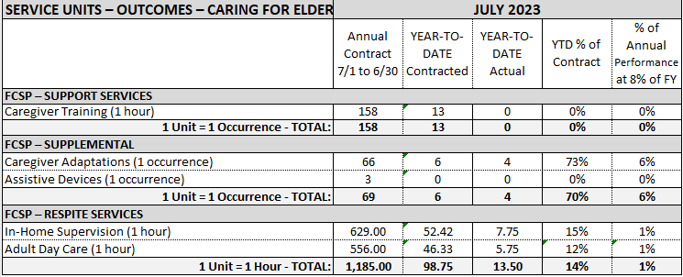
Updated Monthly Program Reports
Monthly Performance Measures
Please send in Excel spreadsheet by the 10th of the following month.
Electronic Signature

Slide 18
Summary of Requirements

Slide 19
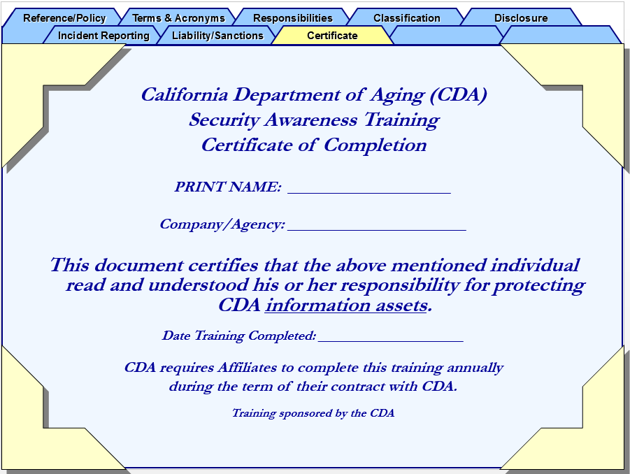
Summary of Requirements Programming
Program & Fiscal Assessments (Monitoring)
1st Year of New Contract – Present to Advisory Council
Performance – Corrective Action Plan (CAPs)
ADA Compliance – Posted
Availability and Eligibility
Mandated Reporter
Annual Mandatory Security Awareness Training
It’s time to renew!

Slide 20
Summary of Requirements Fiscal & Contracts
Monitor Spending
Subcontracts must be approved
Indemnity and Insurance Requirements
Living Wage Ordinance
Single Audit & Financial Reporting

Slide 21
Summary of Requirements Funding Process
BOS Approves VCHSA-AAA to Contract with CDA
Federal Funding
CDA Passes Through Federal & State Funds
California Department of Aging (CDA)
County Board of Supervisors
CDA Contracts with VCHSA-AAA
County GSAApproves All VCHSA-AAA Contracts
VCHSA-AAA
Advisory Council
VCHSA-AAA Contracts with Sub-Grantees and Vendors to Provide Services
County GSA & Auditor-Controller
Advisory Council Helps Determine How VCHSA-AAA Will Spend Funds
Ventura’s Older Adults Receive Services

Slide 22
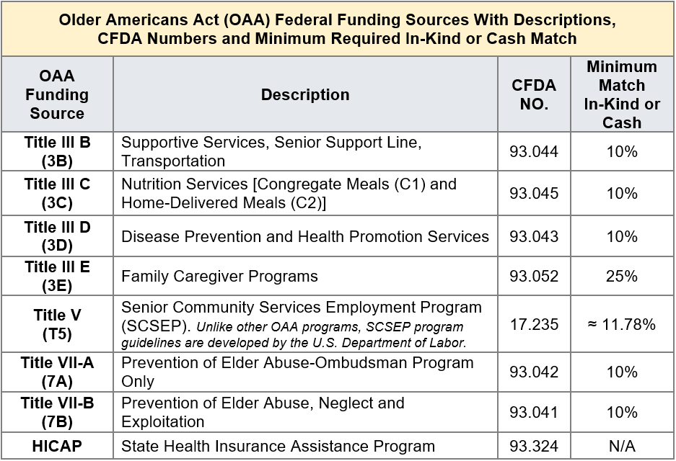
Summary of Requirements Federal Funding Sources

Slide 23
Summary of Requirements
Area Plan Contract Funding for FY23-24

Slide 24
RFFs Submittals
All Requests for Funds (RFFs) are due:
The 20th of the month following service
Email the Excel spreadsheet, a scan of the signed RFF and supporting documents to:
To: Claudia.Castaneda@ventura.org, Alyssa.Corse@ventura.org , Tony.Allen@ventura.org
Cc: FiscalVCAAA@ventura.org

Slide 25
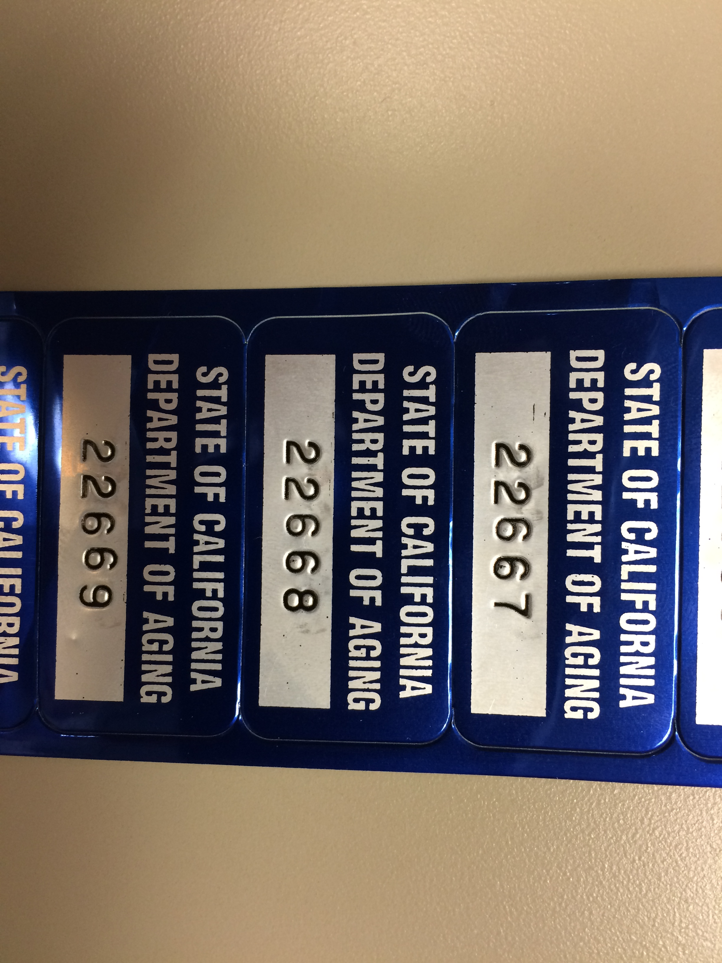
Summary of Requirements Fiscal & Contracts
Grant Modifications – Budget revision if 10% variation
Equipment – Asset Tag
Contract Termination
  Contingent upon availability of funding
  VCAAA gives at least 30 days’ notice for noncompliance
  Grantee may terminate contract on at least 180 days’ notice
Must Have
Approval for Purchase and Disposal!

Slide 26
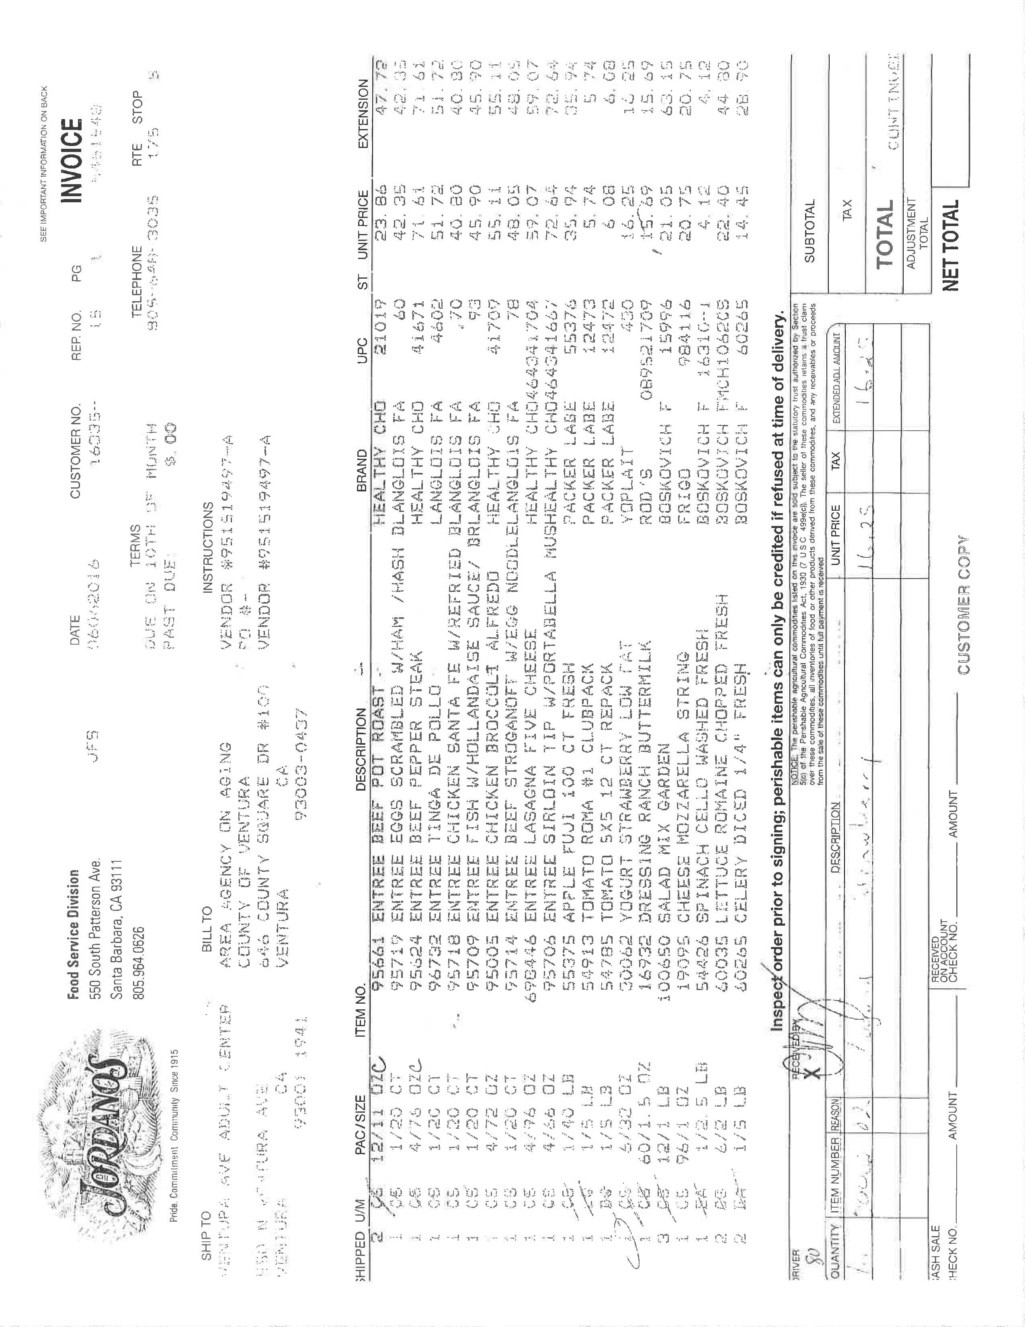
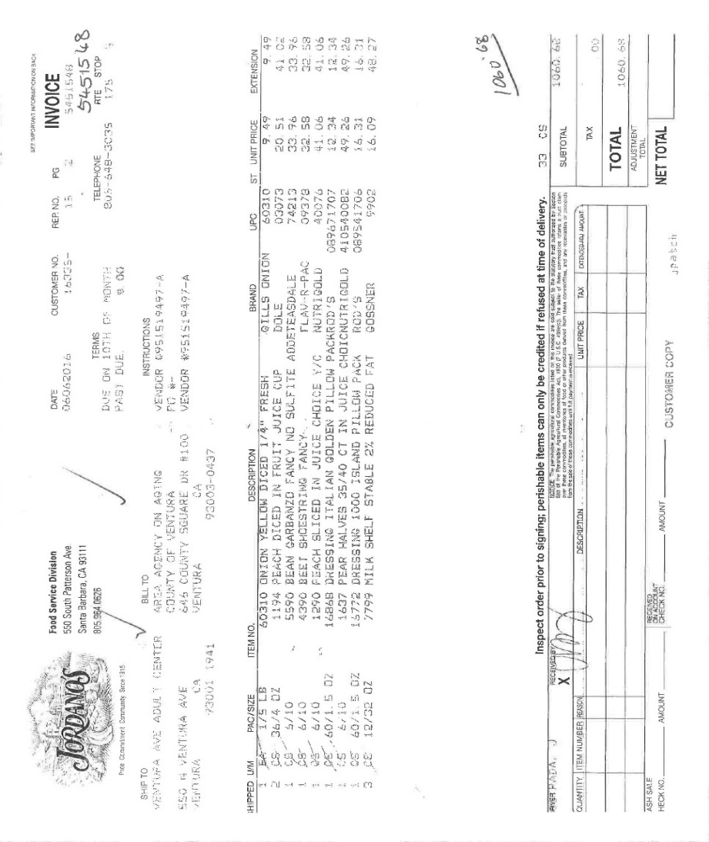
Invoices Submittals
Please submit copy of Jordano’s invoices before the 10th of each month
Please No Faxes
Email Connie Riedmiller
and Fiscal
Connie.Riedmiller@ventura.org
FiscalVCAAA@ventura.org

Slide 27
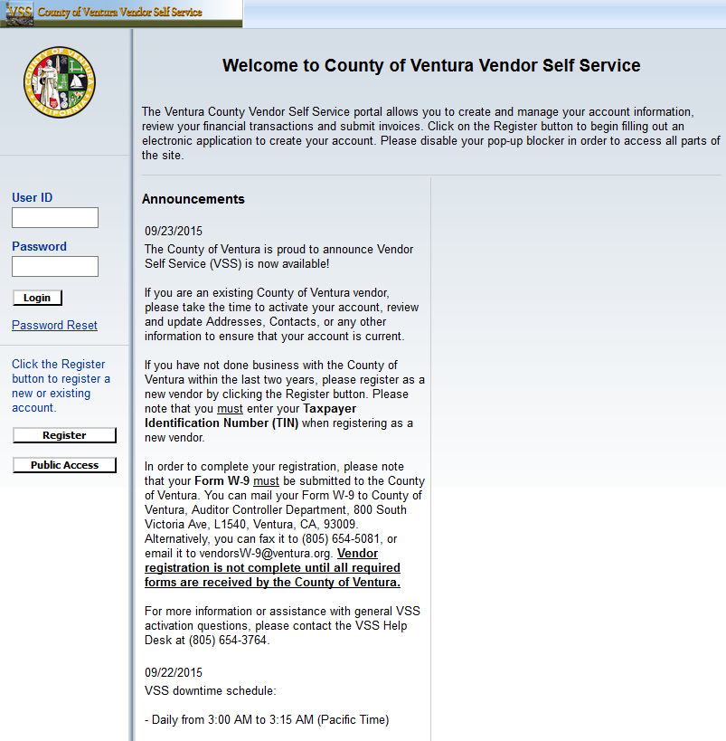
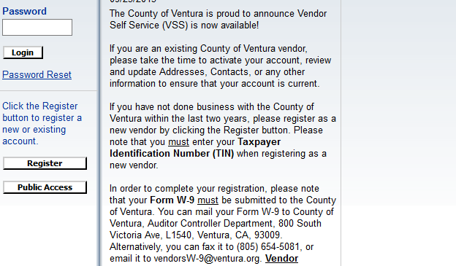
VCFMS (Ventura County Financial Management System)
https://vss.ventura.org/webapp/VSSPSRV1/AltSelfService
(805) 654-3764

Slide 28
Maximum Use of Grant Funding
  Maximum Use of Community Resources and Volunteers
  Coordinating with Other Service Agencies to Avoid Duplication of Effort
  Providing Information about Resources Available to Seniors.
Notes:
We recognize that funding for service programs is inadequate to meet the needs of our seniors, even when service is limited to those in greatest social or economic need as required by the Older Americans Act. Therefore, applicants for funding will be expected to engage in a number of activities that are in addition to the administration and provision of funded services. Such activities include making maximum use of community resources and volunteers; coordinating with other service agencies to avoid duplication of effort; and providing information about resources available to the elderly.

Slide 29
VCHSA-AAA Major Programs & Funding
3500-AAA | REVENUE PROJECTIONS FY2023-24
REV CODE |  | TOTAL | 3501 | 3503 | 3509
9071 | STATE PUBLIC ASSISTANCE PROGRAMS | $3,519,771 | $3,519,771
9111 | STATE MENTAL HEALTH | $769,793 | $769,793
9271 | FEDERAL AGED | $6,794,048 | $3,142,456 |  | $3,651,592
9273 | FEDERAL PUBLIC ASSISTANCE PROGRAMS | $467,085 | $467,085
9351 | FEDERAL OTHER | $612,500 | $612,500
9352 | FEDERAL AID COVID 19 | $354,750 | $354,750
9770 | CONTRIBUTIONS AND DONATIONS | $25,000 | $25,000
9790 | MISCELLANEOUS REVENUE | $0 | $0
9351 | FEDERAL AGED | $1,071,200 | $0 | $1,071,200
 |  | $13,614,147 | $8,891,355 | $1,071,200 | $3,651,592
 | MAJOR PROGRAMS/FUNDING SOURCES | TOTAL | FEDERAL | STATE | OTHER
 | AREA PLAN CONTRACT - VARIOUS PROGRAMS | $4,680,526 | $3,142,456 | $1,538,070 | $0
 | MSSP CONTRACT - CASE MANAGEMENT | $1,071,200 | $1,071,200 | $0 | $0
 | HICAP CONTRACT | $264,239 | $72,724 | $191,515 | $0
 | MIPPA CONTRACT | $13,296 | $13,296 | $0 | $0
 | CALFRESH CONTRACT | $188,931 | $188,931 | $0 | $0
 | SCSEP CONTRACT (TITLE V) | $73,343 | $73,343 | $0 | $0
 | CALAIM | $3,651,592 | $3,651,592 | $0 | $0
 | TRANSPORTATION (FTA 5310 - VCTC) | $345,000 | $345,000 | $0 | $0
 | ADRC (ADULT DISABILITY RESOURCE CENTER) | $528,964 | $0 | $528,964 | $0
 | HCBA (HOME&COMMUNITY BASED ALTERNATIVES) | $210,000 | $210,000 | $0 | $0
 | PEARLS (MHSA - THROUGH HSA) | $769,793 | $769,793 | $0 | $0
 | MOCA (MODERNIZATION OLDER CALIFORNIANS ACT) | $398,650 | $398,650 | $0 | $0
 | ARPA | $354,750 | $354,750 | $0 | $0
 | HCBS (NUTRITION INFRASTRUCTURE) | $300,000 | $300,000 | $0 | $0
 | OARR (OLDER ADULTS RECOVERY & RESILIENCE) | $681,363 | $0 | $681,363 | $0
 | DAVC (XE VICTIMS OF CRIME) | $42,500 | $42,500 | $0 | $0
 | NCOA (BENEFIT ENROLLMENT CENTER SUSTAINABILITY) | $15,000 | $15,000 | $0 | $0
 | CONTRIBUTIONS AND DONATIONS | $25,000 | $0 | $0 | $25,000
 |  | $13,614,147 | $10,649,234 | $2,939,912 | $25,000
 | COUNTY GENERAL FUND | $1,412,465 |  |  | $1,412,465

Slide 30



Thank you …
Nikki’s Casamia
Restaurant & Catering
Grey Law of Ventura County
… for your service to the community!

Slide 31
Moving Contact Information
Ventura County Human Services Agency, Area Agency on Aging
855 Partridge Dr.
Ventura, CA 93003
Fiscal Department
-Brian Murphy
-Tony Allen
-Claudia Castaneda
-Connie Riedmiller
Administration
-Martin Vasquez
-Alyssa Corse

